Slide 1
Association Management System
组员：谢铭扬、温嘉校、胡冬础

Slide 2
Object
Develop an Android application aimed at association management in university. Correctly define the procedures used by the associations and Associations Union such as registration, information lookup, members management and applications approval to reduce the manual effort made in management and facilitate office automation. Satisfy the general needs of association members and administrators and AU administrators.

Slide 3
Requirement
Needs of general member:
(1) General member joins and quits the association.
(2) General member views the basic information of the association, including membership information and activity information, etc.
Needs of association administrator:
(1) Association administrator submits different type of applications, including activity application, reimbursement application, etc.
(2) Association administrator examines and approves the application submitted by general member.
(3) Association administrator can view and modify the association information.
(4) Association administrator adds, deletes and edits documents needed for the daily work of the association.

Slide 4
Requirement (Cont.)
Needs of Associations Union administrator:
(1) Associations Union administrator creates and cancels an association.
(2) Associations Union administrator examines and approves different kinds of applications submitted by the associations and modifies the state of applications.
(3) Associations Union administrator views the information of all associations.
(4) Associations Union administrator edits the material information and modifies the state of material lending.
Needs of system administrator:
(1) System administrator can add and delete system users and import the information of users.
(2) System administrator modifies the authorizations of users.

Slide 5
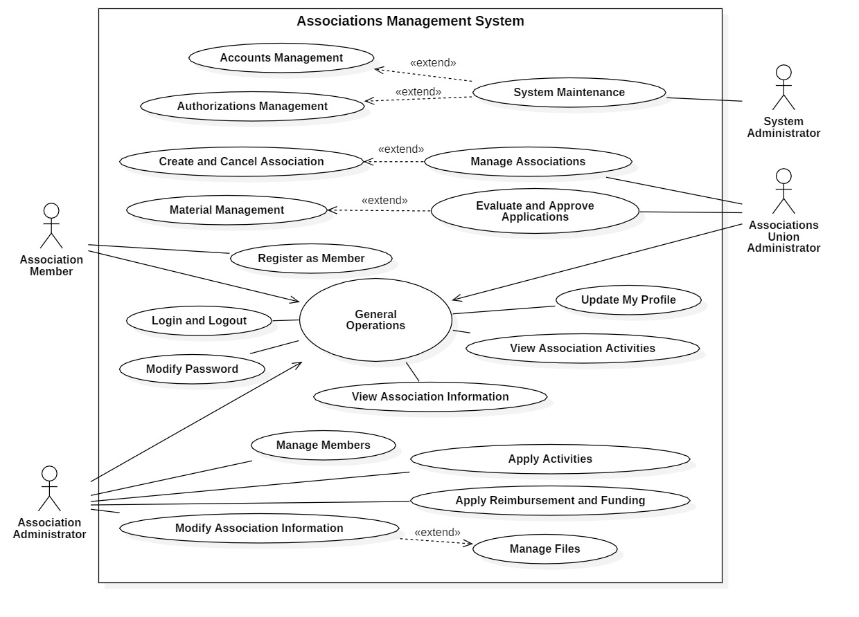
Use Case Diagram

Slide 6
UC1: Conduct General Operations
Scope: Association Management System
Level: user goal
Primary Actor: system administrator, Associations Union administrator, association administrator, general member
Stakeholders and Interests:
- Association administrator: To easily manage basic information, administrative information, and association members information. Being able to submit activities application, apply for reimbursement, apply for funding online. To save and manage association files, activity records, photos, videos, etc.
- Associations Union administrator: To correctly handle all kinds of applications submitted by associations and manage the associations.
- General member: To join and quit the association and to view varieties of information related to the association.
- System administrator: To implement account management and authorization management.
Preconditions: association administrators, AU administrators and general members must be confirmed and certified.

Slide 7
UC1: Conduct General Operations (Cont.)
Main Success Scenario:
1. The user logs in through the username and password, enters the user's main view, and the view is correctly displayed according to the user's role.
A. General members register
1. General members choose the association they want to join
2. General members view the membership fee
3. General members choose their identity
4. General members submit the registration application
5. Application sent appropriately to the association or AU
6. General members exit the application view and return to the main view

Slide 8
UC1: Conduct General Operations (Cont.)
B. General members view information
1. General members choose an association that they join
2. General members select the information they need to view, such as association basic information, members information, activities information, and related documents
3. General members exit the association information view and return to the association selection view
C. Association administrators’ operations
C1. Association administrators manage applicants
1. The association administrators choose the association they take charge of
2. Association administrators choose applications management view
3. Association administrators set membership fee
4. Association administrators view the list of applicants
5. The association administrators approve the applications for those who have paid membership fee
6. The association administrators exit the current association view and return to the association selection view

Slide 9
UC1: Conduct General Operations (Cont.)
C2. Association administrators view and modify information
1. The association administrators choose the association they take charge of
2. Association administrators select information viewing
3. The association administrators select the needed information for viewing and modification, such as basic information, administrative information, members information, association documents, activity records, etc.
4. Association administrators modify the information and save changes
5. The association administrators exit the current association view and return to the association selection view
C3. Association administrators submit applications to Associations Union
1. The association administrators choose the association they take charge of
2. The association administrators choose the type of applications, such as activity application, reimbursement application, funding application, etc.
3. The association administrators submit a new application, modify or cancel the unapproved applications
4. The association administrators exit the current association view and return to the association selection view

Slide 10
UC1: Conduct General Operations (Cont.)
D. Associations Union administrators’ operations
D1. AU administrators manage associations
1. AU administrators choose the associations management view
2. AU administrators manage registration of the association and the cancellation of the association
3. AU administrators change or add or delete the association administrators of each association
D2. AU administrators evaluate and approve the applications submitted
1. AU administrators choose the applications management view
2. AU administrators approve and respond to each application submitted from associations
3. AU administrators modify the state of the application and the state of material lending

Slide 11
UC1: Conduct General Operations (Cont.)
D3. AU administrators view associations information
1. AU administrators choose the association information view
2. AU administrators choose the association to view detailed information pertaining to it
E. System administrators’ operations
E1. System administrators manage system users
1. The system administrators select the user management view
2. System administrators add or remove users
E2. System administrators manage authorizations
1. The system administrators select the authorization management view
2. The system administrators select a user and grant or revoke his association administrator privileges
2. User logs out the system.

Slide 12
UC2: General Member Register
Scope: Association Management System
Level: user goal
Primary Actor: general member, association administrator, Associations Union administrator
Stakeholders and Interests:
- General member: To check the membership fee on the system and apply for registration
- Association administrator: To handle the requests from general members who wants to join the association
- Associations Union administrator: To handle requests that applying for leader of newly-founded association
Preconditions: association administrators, AU administrators and general members must be confirmed and certified.

Slide 13
UC2: General Member Register (Cont.)
Main Success Scenario:
1. General members choose "Apply to join an association" and enter the associations selection view.
2. General members select the association they want to join in the associations list.
3. General members view the membership fee.
4. General members choose their identity: member or leader.
5. For the request to become a member, the application is sent to the corresponding association administrator; for the request to become the leader, the application is sent to the Associations Union administrator.
6. The system prompts “Application successfully sent”.
7. General members click "OK" to return to the associations selection list, and the corresponding association status is changed to "Under Review".

Slide 14
UC3: Submit Applications
Scope: Association Management System
Level: user goal
Primary Actor: Associations Union administrator, association administrator
Stakeholders and Interests:
- Association administrator: Being able to submit activities application, apply for reimbursement, apply for funding online.
- Associations Union administrator: To correctly handle all kinds of applications submitted by associations.
Preconditions: association administrators, AU administrators must be confirmed and certified.

Slide 15
UC3: Submit Applications (Cont.)
Main Success Scenario:
The association administrator logs in the system. If he is the administrator for multiple associations at the same time, selecting one of them to enter the system.
The association administrator initiates an application.
Select application types, which includes activity application, reimbursement application and funding application.
Fill in the necessary information required for the application
4.1 Select the activity application, and fill in the name, holding time and holding place of the activity. Fill in the time and place for advertisement if there is a need to advertise
4.2 Select the reimbursement application, fill in the reasons for the application and the amount of reimbursement
4.3 Select the funding application, fill in the reasons for the funding application, and the amount of funding
Submit the application and wait for the AU administrator to approve the application. Association administrator can check the status of the submitted application.
After the application is approved, the system notifies the administrator that the application has been approved and the application is completed.

Slide 16
UC3: Submit Applications (Cont.)
Extension:
5.a Cancel the application
1. If the application has not been approved, association administrator can choose to cancel the application. Before the application is cancelled, the system needs to confirm with the user again whether to cancel the application.
6.a The application is rejected
1. The system notifies the association administrator that the application fails, and the association administrator checks the reasons for the failure.
2. Association administrator can choose to cancel the application or modify the application information to apply again.

Slide 17
UC4: Examine and Approve Applications
Scope: Association Management System
Level: user goal
Primary Actor: Associations Union administrator
Stakeholders and Interests:
- Associations Union administrator: To correctly handle all kinds of applications submitted by associations.
Preconditions: AU administrators must be confirmed and certified.

Slide 18
UC4: Examine and Approve Applications (Cont.)
Main Success Scenario:
1. The AU administrator enters the user main view.
2. The AU administrator chooses the application management view.
3. The AU administrator checks the specific application information, which includes activity application, reimbursement application and funding application.
4. The AU administrator can check the loanable status of the applied materials or venues.
5. The AU administrator decides whether to approve the application based on the actual situation.
6. The AU administrator responds to the application.
7. The AU administrator modifies the status of the application and the loanable status of the materials.
The AU administrator repeats steps 3-7 until all the applications is processed.
8. The AU administrator exits the application management view and returns to the main view.

Slide 19
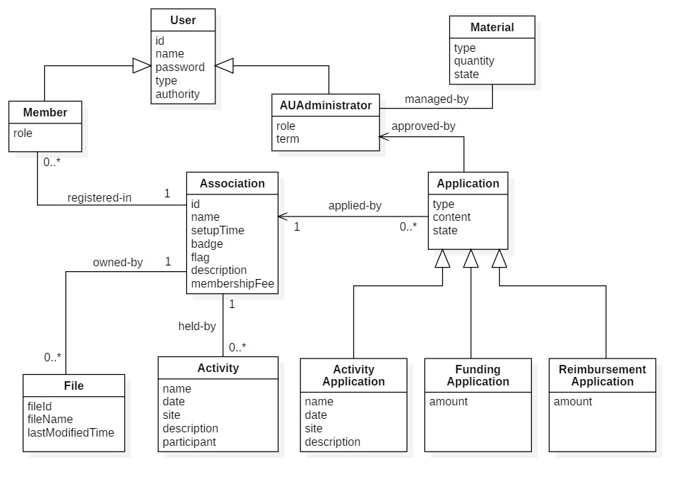
Domain Model

Slide 20
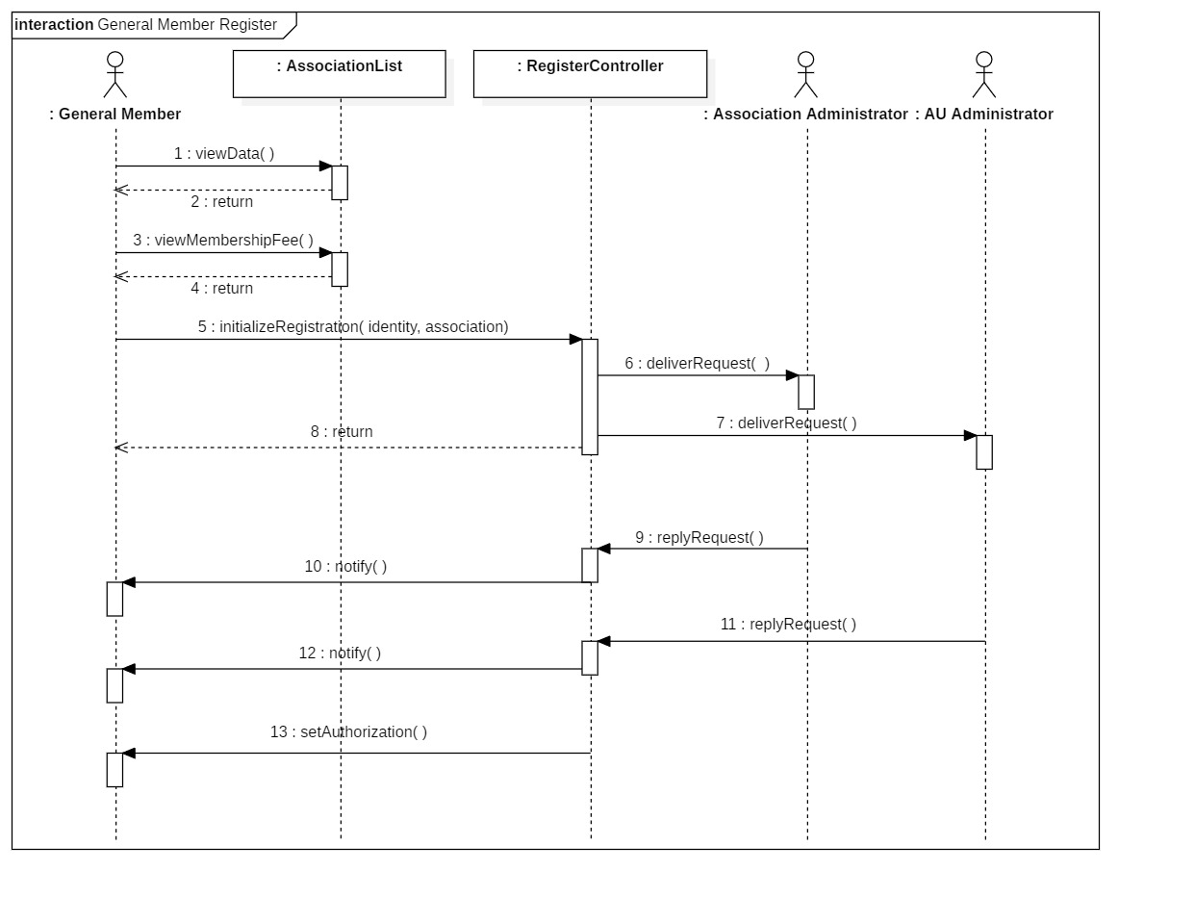
Sequence Diagram for General Member Registration

Slide 21
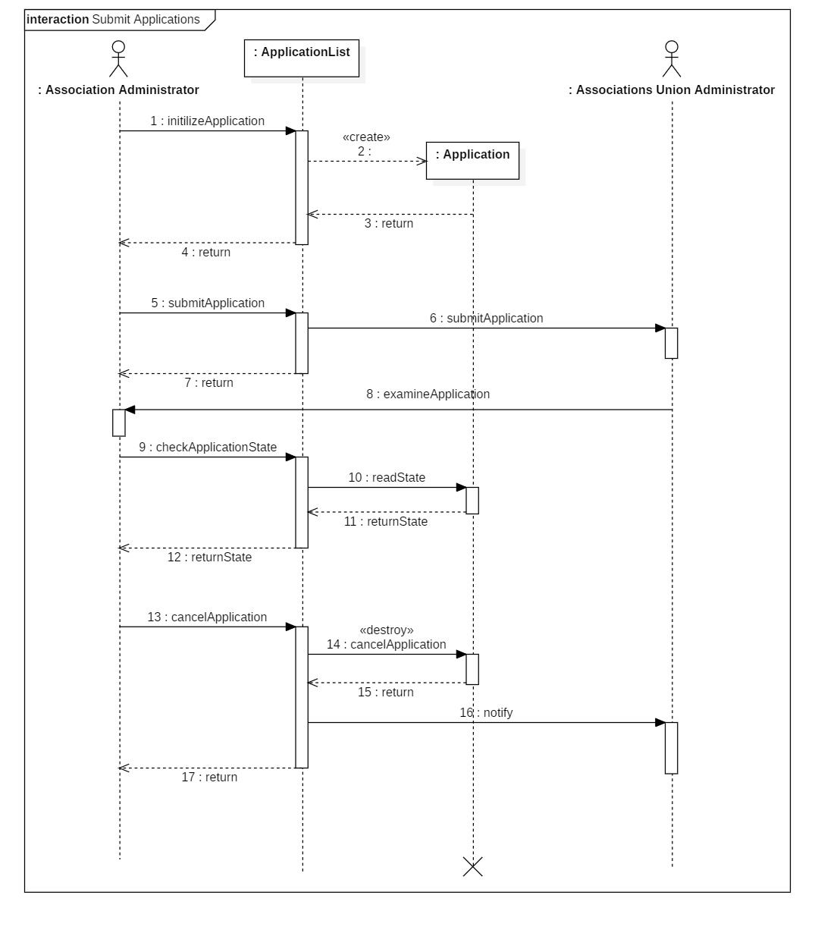
Sequence Diagram for Submitting Applications

Slide 22
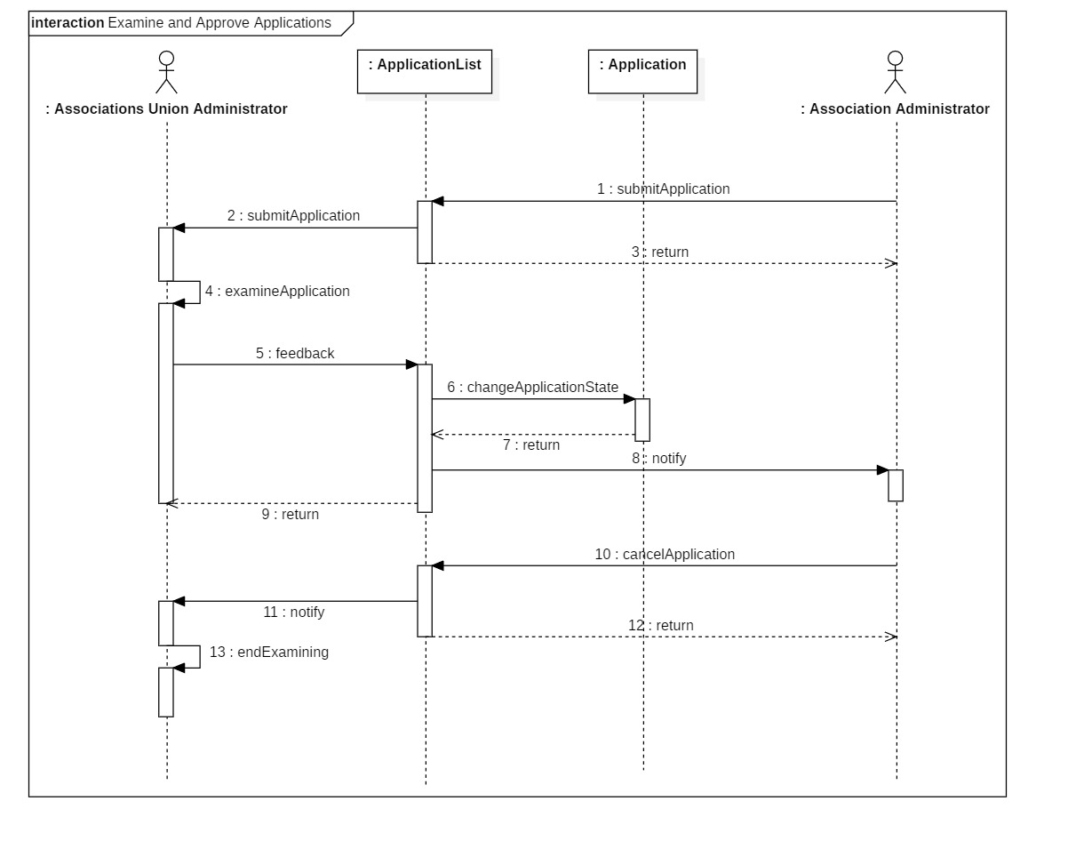
Sequence Diagram for Examining and Approving Applications

Slide 23
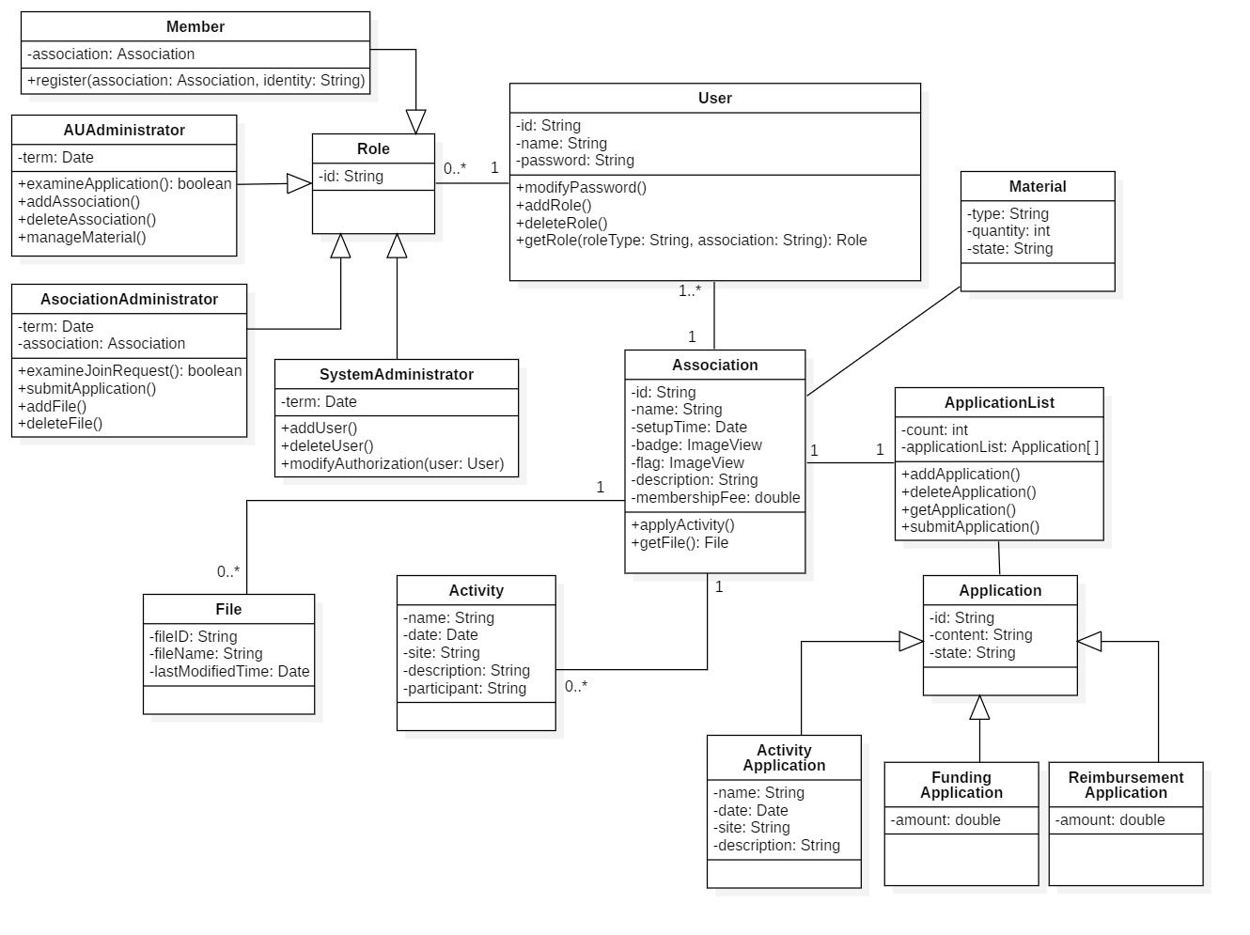
Class Diagram

